Slide 1
Electricity flows to your lights and appliances from the power company through your panel, its breakers, out on your circuits and back. Here is a schematic picture of all the major parts of your home electrical system.

Slide 2
.Electricity flows to your lights and appliances.
from the power company through your panel,
its breakers, out on your circuits and back
Here is a schematic picture of all the major parts
of your home electrical system.

Slide 3
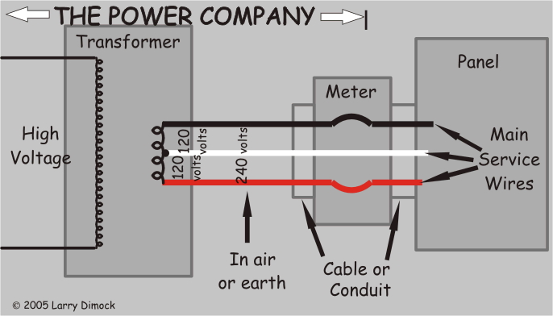

Slide 4
FLOW OF ELETICITY IN
HOME
Two of the transformer's terminals are isolated from the earth and the third is connected to the earth. We call these isolated wires "hot" or "live" because anything even slightly connected to the earth (like us!)
when touching a hot wire, provides, along with the earth, an accidental path for electricity to flow between that wire and the transformer's "grounded" terminal

Slide 5
CONT......
Hot wires are distributed into your home from a number of circuit breakers or fuses in your panel. Hot wires are typically black, occasionally red or even white, and never green or bare.
The earth-related neutral wires in your home are also distributed from your panel, but from one or two "neutral bars". Neutral wires are always supposed to be white.

Slide 6
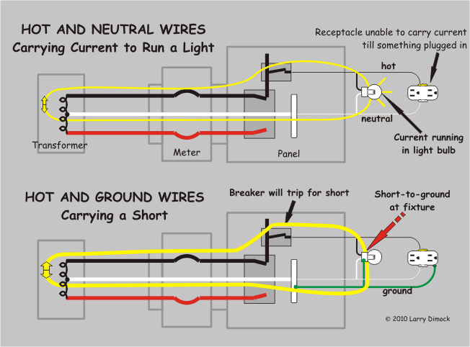

Slide 7
REQUIREMENTS
Electric meter
GSM/GPRS Module
Microcontroller
MAX 232 IC

Slide 8
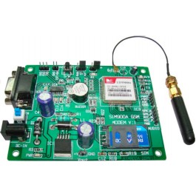

Slide 9
You need only two wire( TX , RX ) except Power supply to interface with microcontroller / Arduino . The built in Power supply allows you to connect wide range unregulated power supply .
Using this modem , you can send SMS, data and read SMS through simple AT command.
Description : This GSM module is built with the advance SIM900 engine, works on frequencies EGSM 900 MHz, DCS 1800 MHz and PCS 1900 MHz. It is very compact in size and easy to use as plug in module .
The Modem is coming with RS232 interface,which allows you to connect directly to PC or microcontroller / Arduino .

Slide 10
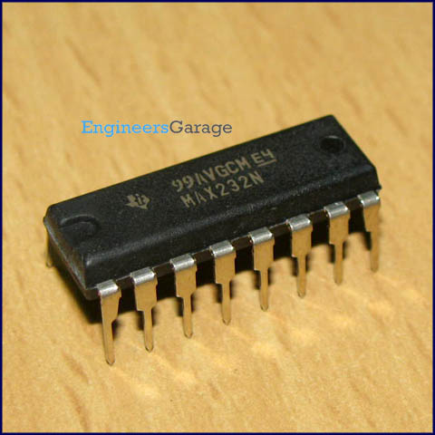
MAX232 IC

Slide 11
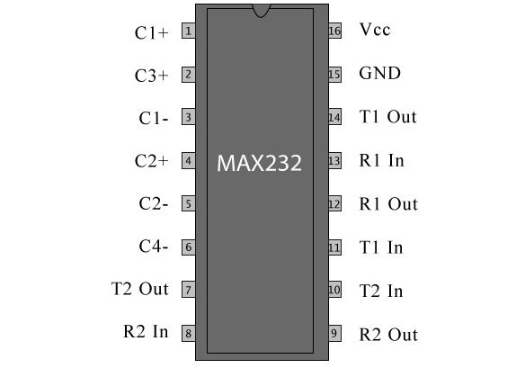
PIN CONFIGURATION MAX232 IC

Slide 12
DESCRIPTION OF MAX232 IC
The MAX232 is an IC,that converts signals from an RS-232 serial port to signals suitable for use in TTL compatible digital logic circuits.
The MAX232 is a dual driver/receiver and typically converts the RX, TX, CTS and RTS signals.

Slide 13
BOX
Material
Aluminium – Difficult to bend. So time taking process to ` manufacture. High temperatures are required for manufacturing
Mild Steel – Hard to make thin boxes of thickness 0.1 cm.
Plastic – Good to use but Magnetic field cannot be passed through it.
GI Sheet (Galvanised Iron Sheet) – Very easy to bent and to transform into any shape and also can make magnetic field to pass through it.

